Slide 1

Topic: Overview of my TESLA company

Slide 2

Identity
Name : Akash Hossain
Batch No : 20
Department : Economics

Slide 3
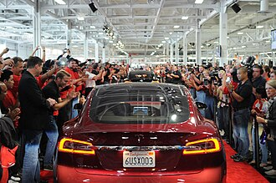
Brief Introduction
Tesla, Inc. is an American multinational automotive and clean energy company. Headquartered in Austin, Texas, it designs, manufactures and sells battery electric vehicles (BEVs), stationary battery energy storage devices from home to grid-scale, solar panels and solar shingles, and related products and services.

Slide 4
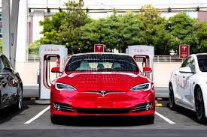
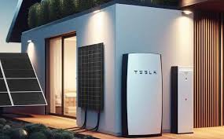
Key products and services
Battery electric vehicles (BEVs)
Stationary battery energy storage devices from home to grid-scale
Solar panels and solar shingles
Electric car

Slide 5

Advertisement

Slide 6
Statistical data of Tesla
Years | Sales
2019 | 300885
2020 | 442562
2021 | 911242
2022 | 1247146
2023 | 1739707
2024 | 369783

Slide 7
Smart Art
Bangladesh
Argentina
Brazil

Slide 8

Conclusion
Every vehicle boasts stylish design, premium materials, and high-performance car parts. More specifically, Tesla achieves this “ high performance” status with advanced touchscreens, over-the-air updates, sophisticated battery tech, and autonomous driving capabilities.
Contact:
Cell Tesla : 877-798-3752
Email Tesla :press@tesla.com

Slide 9

THANK YOU!!!!

